Slide 1

革新全球收银管理
Revolutionize global cash register management
爱宝美食云海外版收银系统
Aibao Food Cloud Overseas Version Cash Register System
广州市贺氏办公设备有限公司
Guangzhou Heshi Office Equipment Co., Ltd

Slide 2
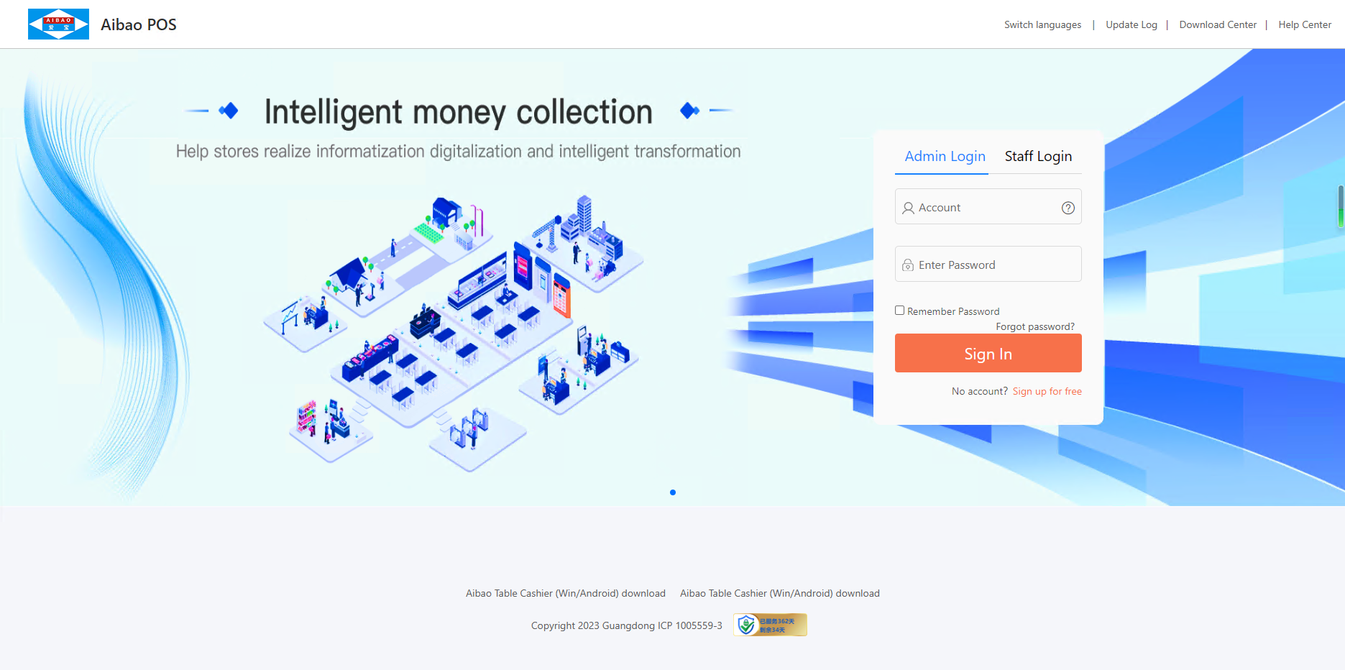
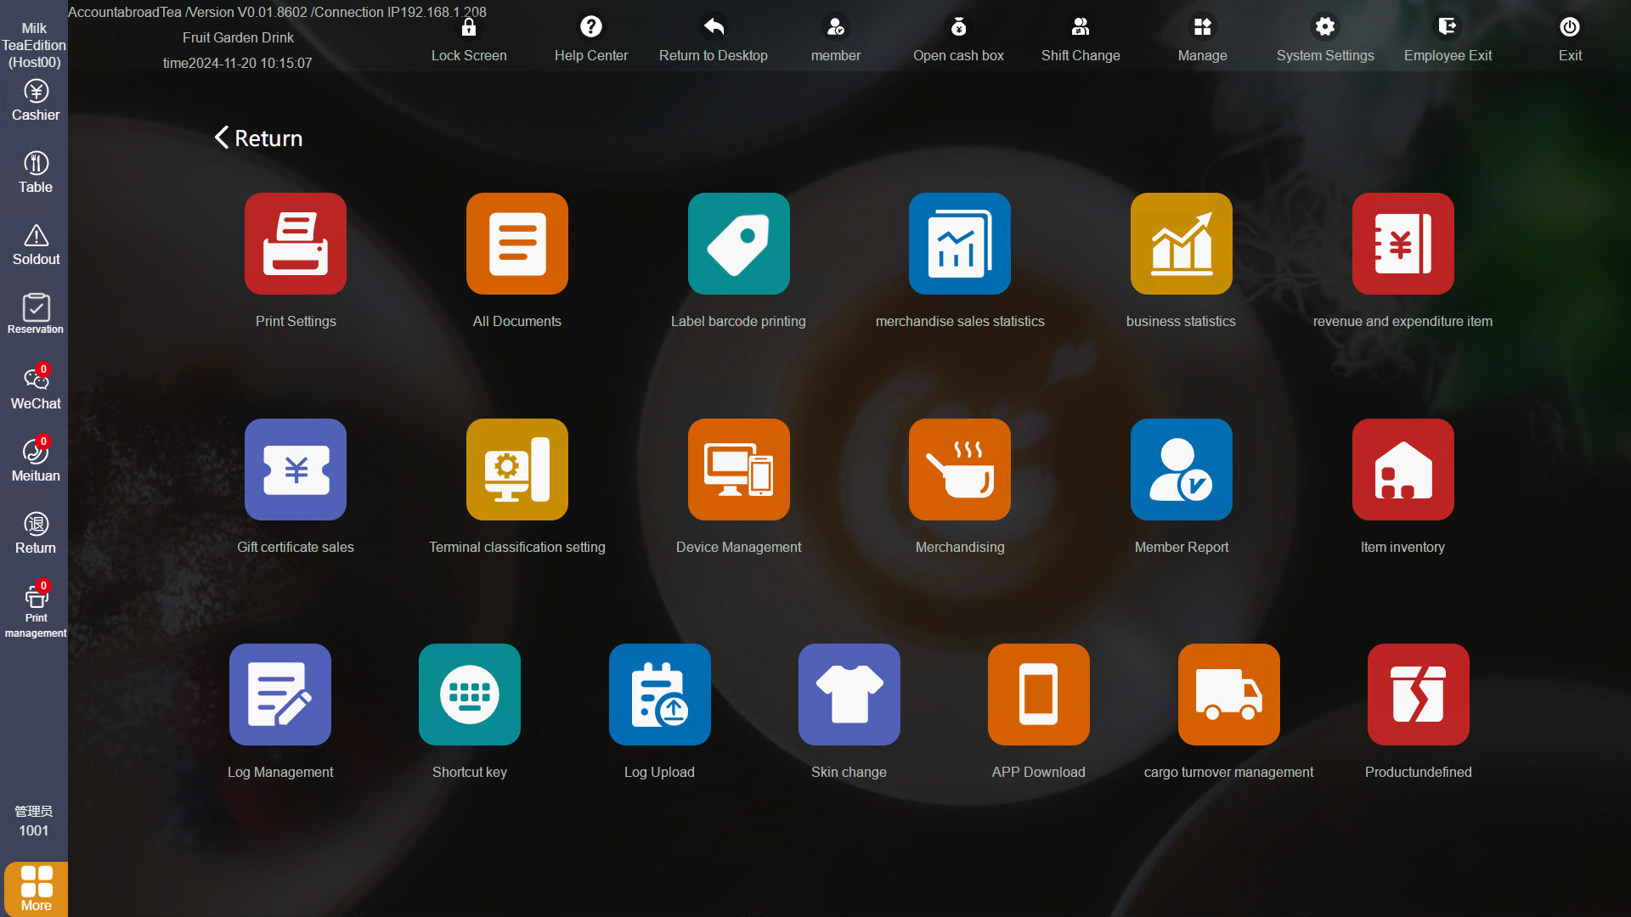
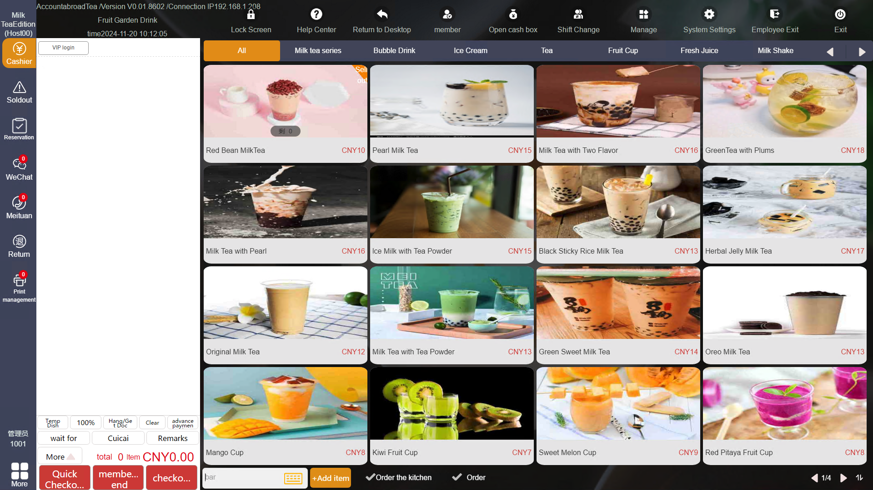
美食云海外版一体化收银方案
The overseas version of the integrated cashier solution of Meishiyun
爱宝美食云海外版一体化收银方案
The overseas version of the integrated cashier solution of Meishiyun
爱宝美食云海外版是专为全球餐饮商户打造的智能收银解决方案，支持多国语言界面，操作简洁直观，新人无需培训即可快速上手。系统集PC收银、移动点餐、云管家于一体。
Aibao Food Cloud Overseas Edition is an intelligent cash register solution specially designed for global catering merchants. It supports multiple language interfaces and is simple and intuitive to operate. Newcomers can quickly get started without training. The system integrates PC cash register, mobile ordering and cloud management.
爱宝美食云海外版收银方案可减少订单错误率80%，提升出餐时效15%-25%。
The overseas version of the cash register solution of Aibao Food Cloud can reduce the order error rate by 80% and improve the meal preparation time by 15% to 25%.
广泛适用于快餐、奶茶、酒楼、烘焙等各类餐饮业态及休闲娱乐场所。
It is widely applicable to various catering formats such as fast food, milk tea, restaurants, and bakeries, as well as leisure and entertainment venues.

Slide 3
001
核心功能
CORE FEATURES DISPLAY
想了解更多功能，欢迎官网下载试用www.biash.com
Want to explore more features? Download and try from our official website: www.biash.com
断网收银（Fast food brands in the offline）
快餐模式/酒楼模式（Fast food model/restaurant model）
称重模式（Weighing mode）
智能餐厅（Smart Restaurant）
手机点莱宝（Mobile Ordering Treasure）
4G点菜手机app（4G Ordering mobile app）
时段管理（Time period management）
炒菜机器人（Cooking robot）
会员人脸识别 （Member facial recognition）
语言切换（Language switching）
第三方支付快速收款（Quick collection through third-party payment）
组合支付（Combined payment）
电子发票(全电) （Electronic invoice
AI智能识物收银（ai intelligent object recognition and cash register）
结账会员查询（Checkout member inquiry）
more......
收银功能
CASH REGISTER FUNCTION
进销存管理（Inventory management）
商品管理（规格、价格、优惠力度、口味、标签等）（Commodity management (specifications, prices, discount magnitudes, labels, etc.)）
供应商管理（Supplier Management）
云商品库（Cloud Product Library）
临时菜品管理（Management of temporary dishes）、
套餐设置（Package Settings）
提成方式（Commission method）
线上扫码商品管理（Online QR code product management）
起售份数与递增基数（Minimum number of shares for sale and increment base）
计量单位与数量（Units of measurement and quantities）
后台更换打印机（Replace the printer in the background）
输入框直接扫69码（Scan code 69 directly in the input box）
商品按位加入购物车初始库存（Add the items to the shopping cart in order of their initial inventory）
more......
商品管理
COMMODITY MANAGEMENGT
库存报表（Inventory report）
库存盘点（Inventory check）
商品出入库（Goods entry and exit from the warehouse）
原材料出入库（Raw material entry and exit from the warehouse）
库存报损（Inventory write-off）
库存预警（Inventory warning）
单位换算（Unit conversion）
商品成本明细（Details of commodity costs）
库存模版（Inventory template）
库存批次（Inventory batch）
组装拆分（Assembly and disassembly）
more......
库存管理
INVENTORY MANAGEMENT
会员管理（Member Management）
会员营销（会员权益包：开卡有礼、满减满赠、充值有礼、累计赠礼、集点营销、精准营销、签到有礼、生日营销、升级送礼等）（Member marketing member benefits package：Card opening gifts, discounts and gifts for reaching certain spending amounts, rewards for recharging, cumulative gifts, point collection marketing, precise marketing, sign-in gifts, birthday marketing, upgrade gifts, etc）
会员人脸识别（Member facial recognition）
会员标签（Member Tag）
会员画像（Member Profile）
明华IC制卡/读卡（Minghua IC card making/reading）
积分管理（Points management）
次卡（Secondary card）
微会员（Micro Member）
连锁会员共享（Shared by chain members）
会员短信认证（Member SMS authentication）
more......
收银功能
会员功能
MEMBERSHIP FUNCTION

Slide 4
001
核心功能
CORE FEATURES DISPLAY
想了解更多功能，欢迎官网下载试用www.biash.com
Want to explore more features? Download and try from our official website: www.biash.com
茶位费（Tea service fee）
服务费（Service fee）
计时/包场/分段收费（Time-based/private booking/segmented charging）
计时到钟提醒（Time reminder when the clock is up）
开台设置（Channel setup）
扫桌码点餐（Scan the table code to order food）
转台/搭台/留台/联台/拆台/并台/撤台（Turntable/Build a platform/keep a platform/link a platform/dismantle a platform/merge a platform/withdraw a platform）
桌台菜单与包房价（Table menu and package room rates）
点餐距离限制（Distance limit for ordering）
结算押金管理（Settlement deposit management）
桌台排序（Table arrangement）
预约桌台（Reservation desk）
单独餐前支付设置（Individual pre-meal payment Settings）
more......
餐桌管理
TABLE MANAGEMENGT
门店管理（Store management）
进货管理（Purchasing management）
分店调货（Branch store transfer of goods）
一键复制商品开店（One-click copy of products to open a store）
货流管理（Cargo flow management）
总店管理（Head store management）
连锁区域管理（Chain area management）
会员共享（Member sharing）
跨店支付查询（Cross-store payment inquiry）
连锁共享券（Chain shared coupon）
连锁店会员IC卡（Chain store membership IC card）
分店报表查询（Branch store report query）
支付信息复制分店（Copy the payment information to the branch store）
more......
连锁管理
COMMODITY MANAGEMENGT
点菜宝APP:收银、点餐管理、会员部分管理、桌台管理等（Cashiering, food ordering management, member section management, table management, etc）
云秘书APP:门店订货管理、预约管理、商品管理、规格管理、会员管理、员工管理、促销管理、原材料管理、库存管理、报表管理等（Store order management, reservation management, product management, specification management, member management, employee management, promotion management, raw material management, inventory management, report management, etc）
手机收银APP:收银管理、点餐管理、桌台管理、菜品管理、打印机管理、储值卡支付验证、4G流量共享收银台等（Cash register management, ordering management, table management, dish management, printer management, stored-value card payment verification, 4G data sharing cash register, etc）
more......
APP管理
APP MANAGEMENT
针式打印机（Dot matrix printer）
热敏打印机（Thermal printer）
标签打印机（Label printer）
云打印机（Cloud printer）
计价秤（Pricing scale）
传统点菜宝（Traditional Ordering Treasure）
消费机（Consumption machine）
人脸消费机电子盘餐（Facial recognition consumption machine electronic plate）
平板点餐（Tablet ordering）
副屏广告（Secondary screen advertisement）
副机（Auxiliary machine）
自助点餐机（Self-service ordering machine）
读卡器（Card reader）
条码秤（Barcode scale）
字符叠加器（Character overlay）
炒菜机器人（Cooking robot）
人脸识别摄像头（Face recognition camera）
more......
收银功能
硬件支持
HARDWARE SUPPORT

Slide 5
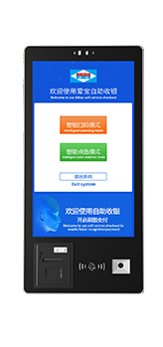
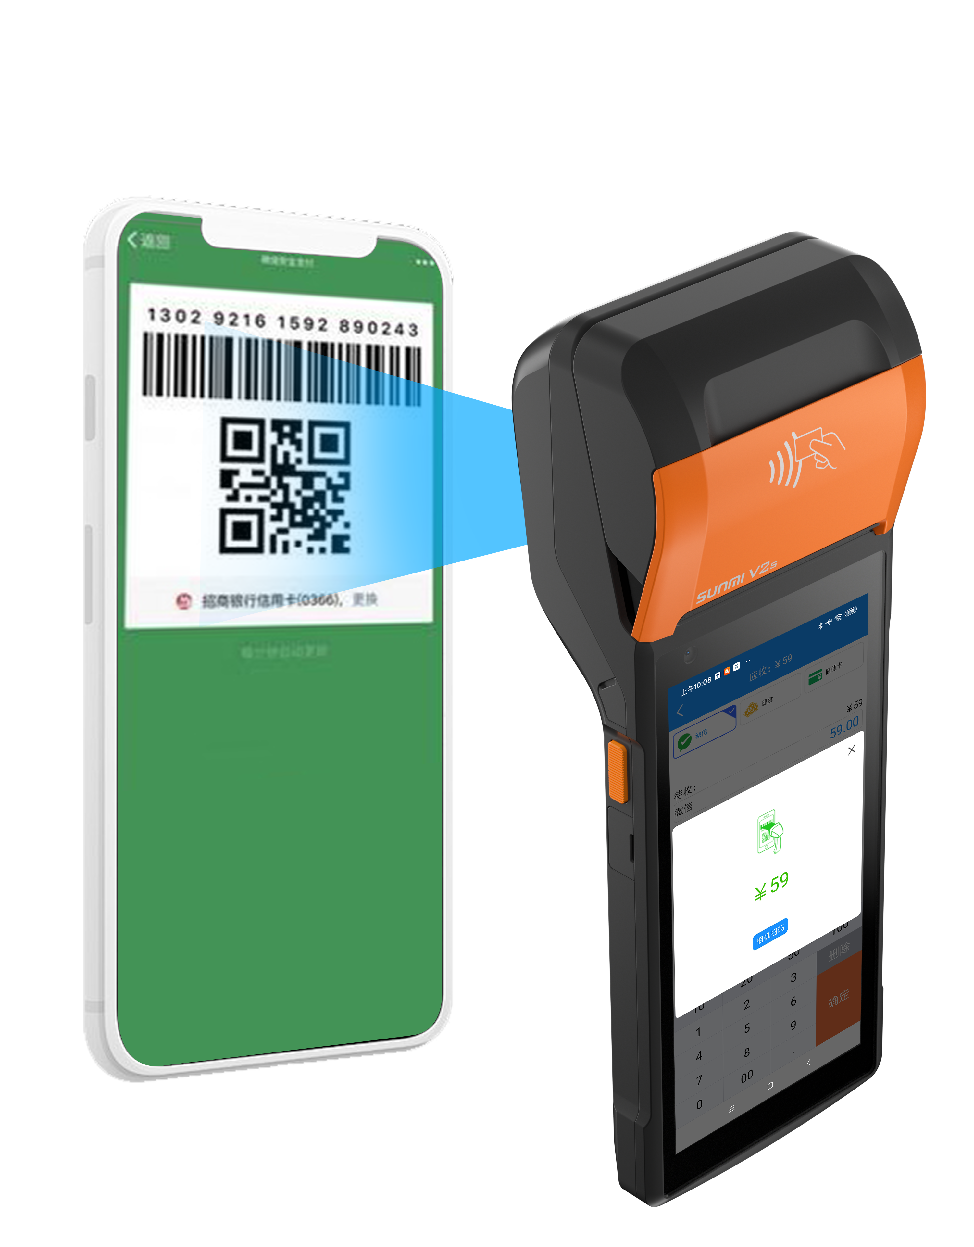
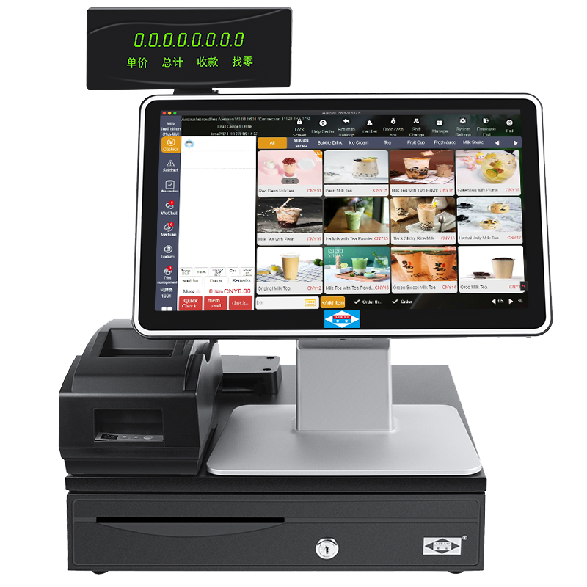
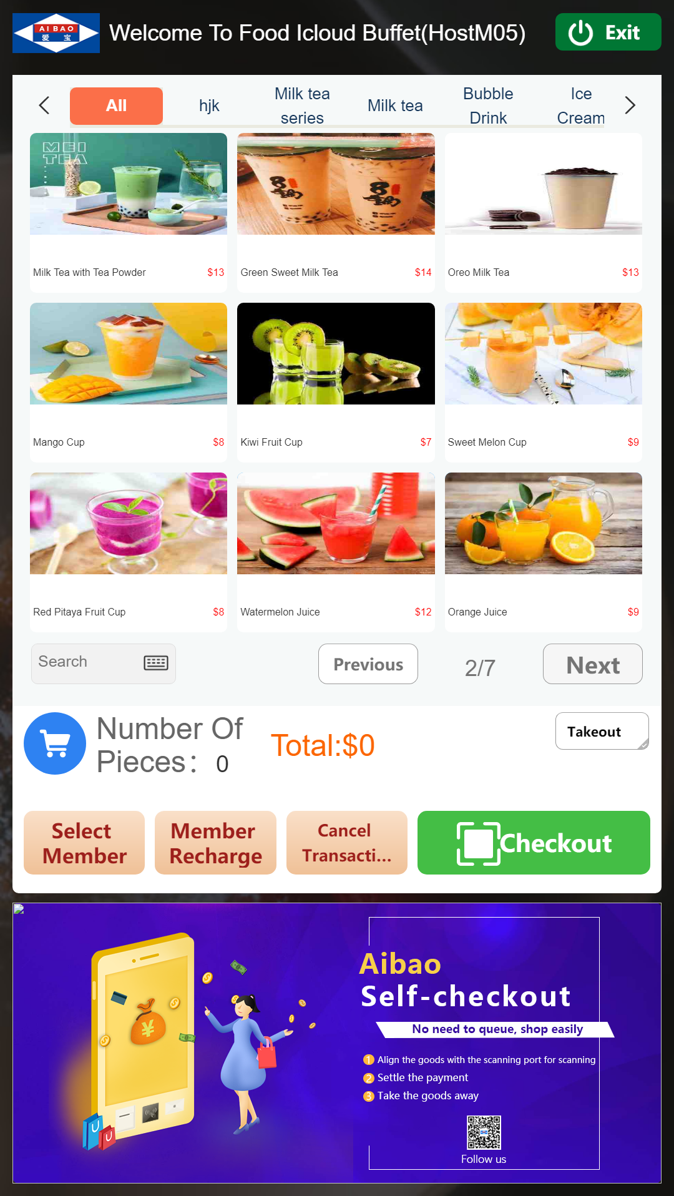
技术优势-支持不同终端收银
Technical advantage - Supports different terminal cash registers
想了解更多功能，欢迎官网下载试用www.biash.com
Want to explore more features? Download and try from our official website: www.biash.com
爱宝美食云海外版支持网页版和客户端后台，前台收银同时兼容安卓、windows系统，兼容安卓移动POS、自助收银、自助售货机。
Aibao Food Cloud Overseas Version supports web and client backend, with front-end checkout compatible with Android and Windows systems, as well as Android mobile POS, self-service checkout, and vending machines.
支持安卓版/PC端
Supports both Android and PC versions of cash registers
支持点菜宝
Support Dian Mian Bao for cash register
支持自助机
Supports self-service machines

Slide 6
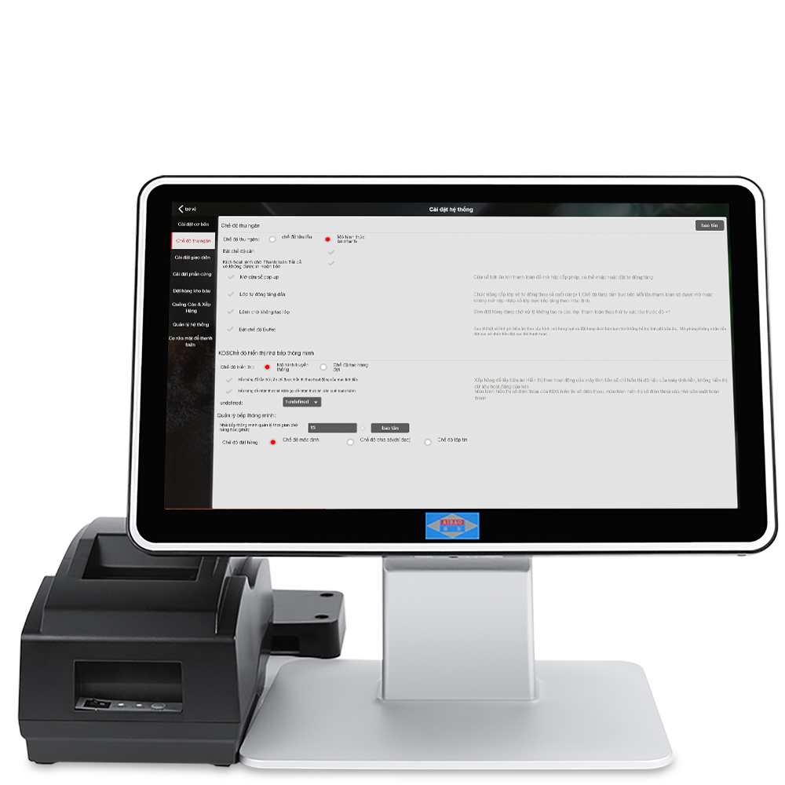
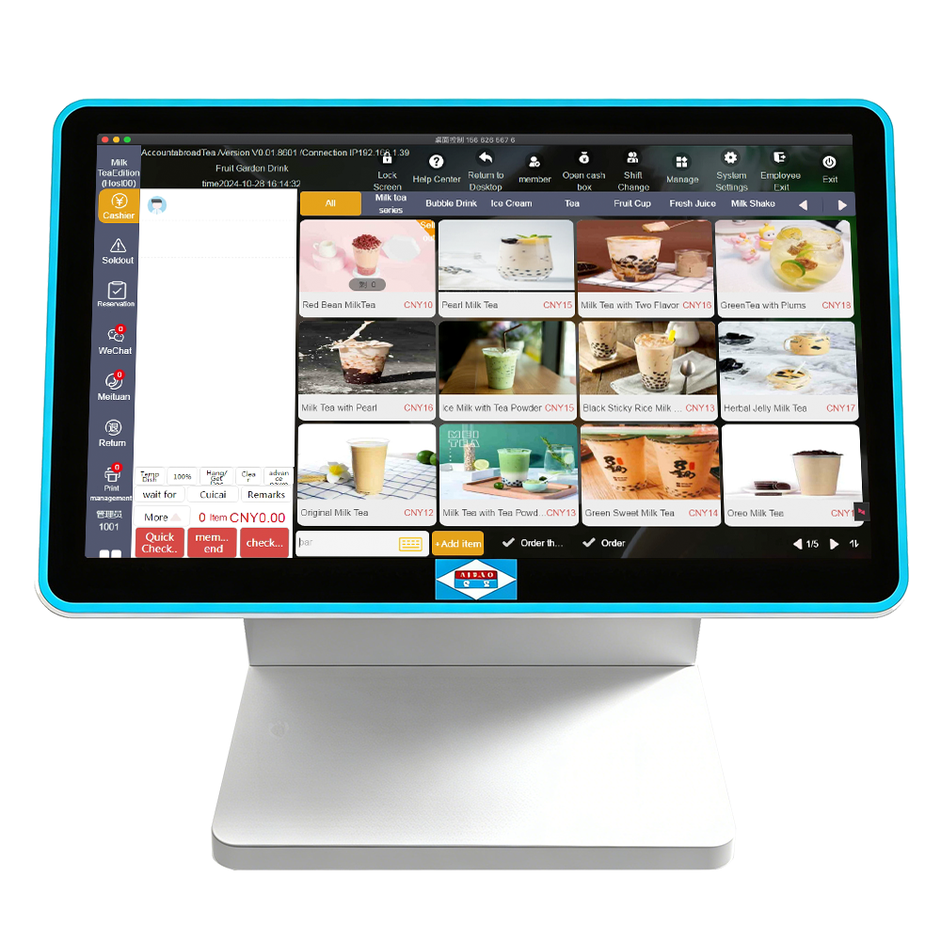
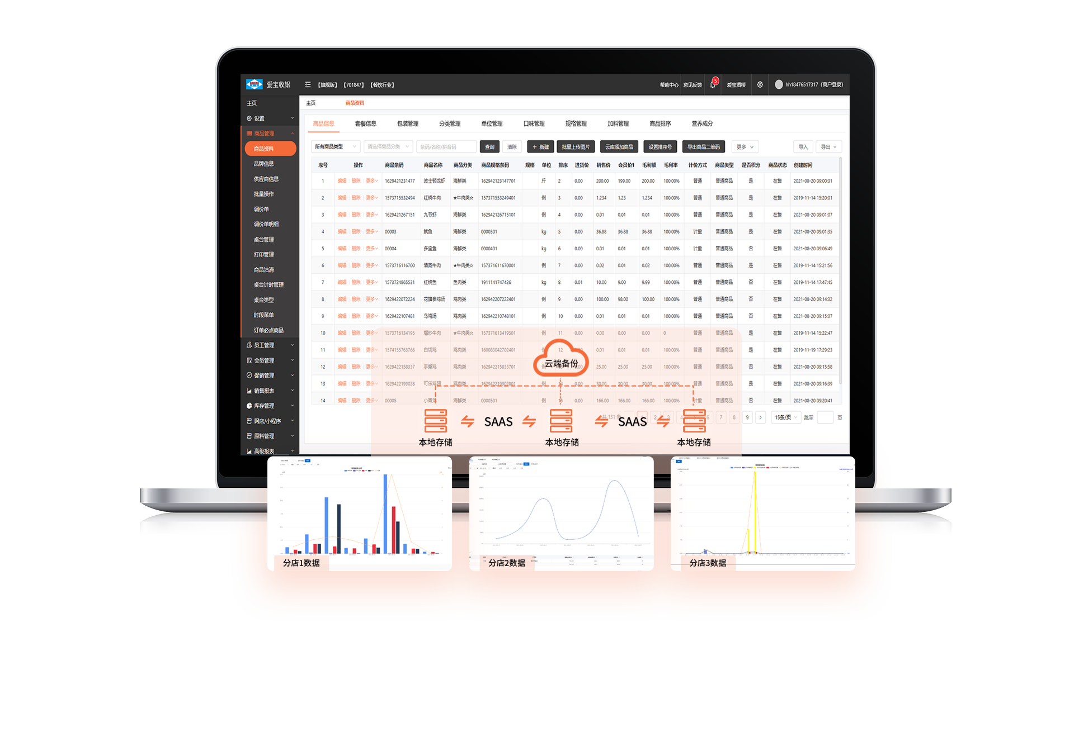
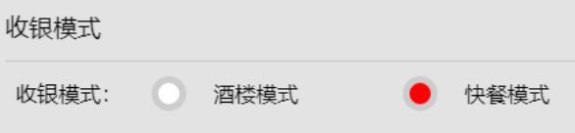

002
技术优势-智能收银系统
Technical advantage - Intelligent cash register system
想了解更多功能，欢迎官网下载试用www.biash.com
Want to explore more features? Download and try from our official website: www.biash.com
收银功能
快餐模式 & 酒楼模式双模式切换
Switch between fast food mode and restaurant mode
支持大图片点餐、副屏视频广告
Support large image ordering and secondary screen video advertisements
本地存储+云端同步，断网可用
Local storage + cloud synchronization, available even when disconnected from the Internet

Slide 7
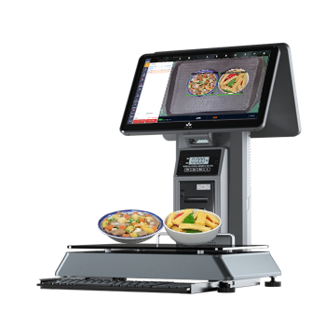
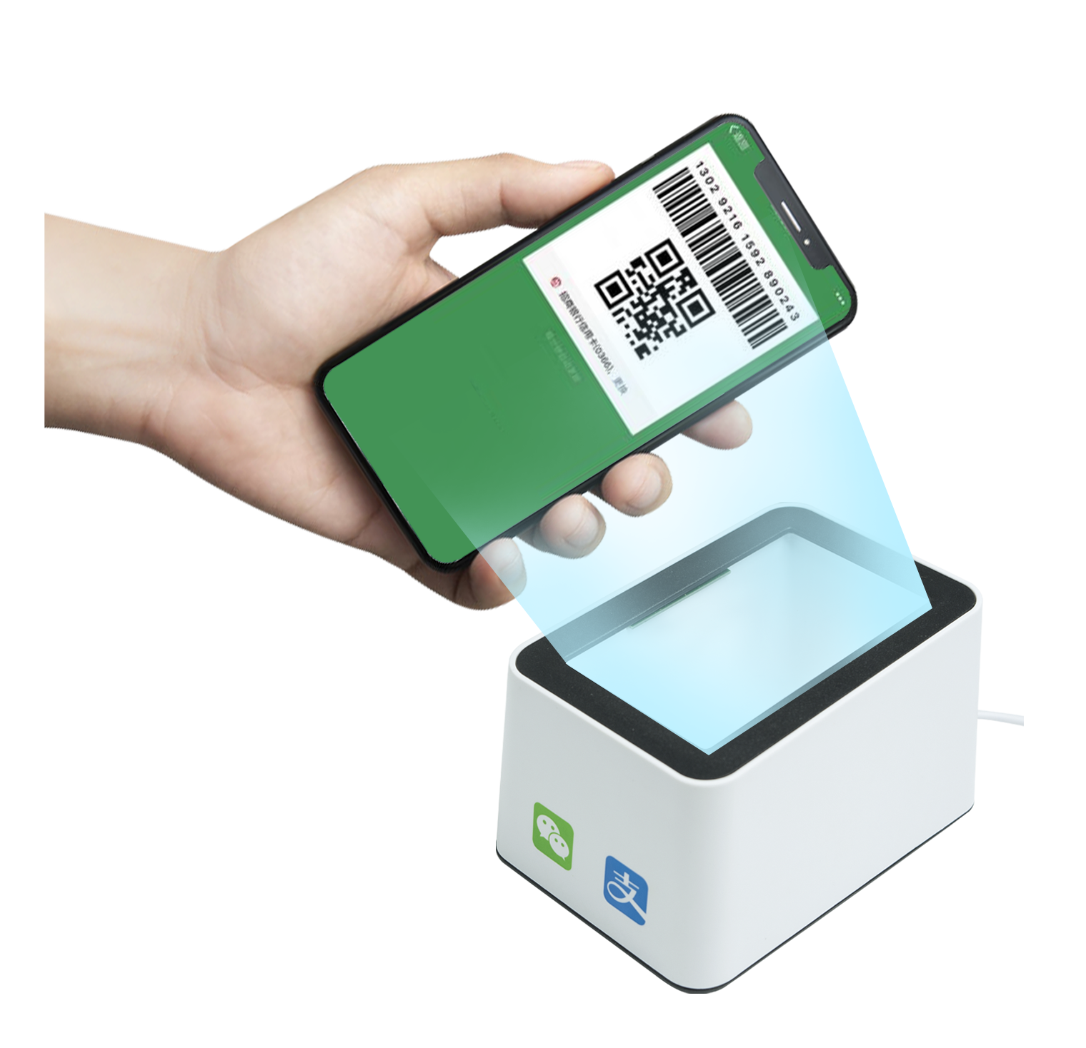
技术优势-AI菜品识别功能
Technical advantage - AI Dish Recognition Function
想了解更多功能，欢迎官网下载试用www.biash.com
Want to explore more features? Download and try from our official website: www.biash.com
爱宝美食云海外版适配自助称重收银设备，支持顾客自主完成菜品识别、称重、付款的全流程操作，无需专人值守收银台。
Aibao Catering Cloud Overseas Version is fully compatible with self-service weighing and checkout devices, enabling customers to independently complete the entire process of dish recognition, weighing and payment without the need for dedicated cashier attendance.
将商品放于电子秤或者托盘上，重量稳定后可以直接扫微信付款；或者识别后自动付款。
Place items on the electronic scale or tray. Once the weight stabilizes, you can scan WeChat Pay directly for payment, or enable automatic payment after recognition.
优化人力结构，降低长期运营成本。
This optimizes the labor structure and reduces long-term operational costs.

Slide 8
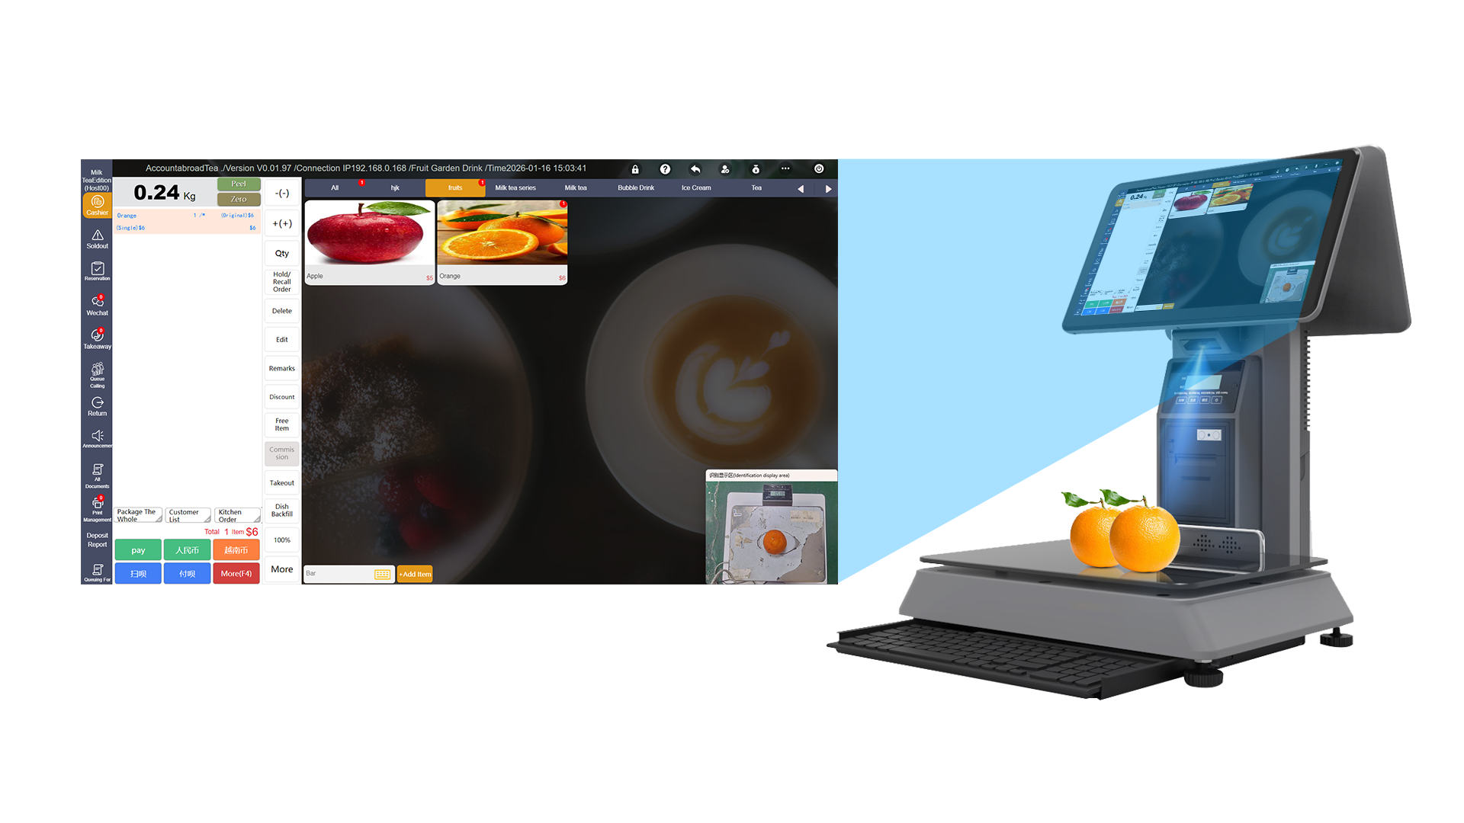
002
技术优势-支持零售业态AI智能识物收银
Technical Advantage: AI-Powered Visual Checkout for Retail
想了解更多功能，欢迎官网下载试用www.biash.com
Want to explore more features? Download and try from our official website: www.biash.com
AI技术，精准识别商品，一放一点一扫码，无需繁琐操作实现收银三步曲。优化消费流程、提高超市服务效率，降低人力成本。
AI technology accurately recognizes products—simply **place, tap, and scan** to complete a streamlined three-step checkout with no complicated operations. It optimizes the checkout process, enhances supermarket service efficiency, and reduces labor costs.
收银功能
识别率>99.95% Recognition rate >99.95%
识别速度≥200毫秒Recognition speed ≥200 milliseconds
回购率> 50%
Repurchase rate > 50%
人工成本节约30% Labor cost savings: 30%
工作效率提高50%
Work efficiency improvement: 50%

Slide 9
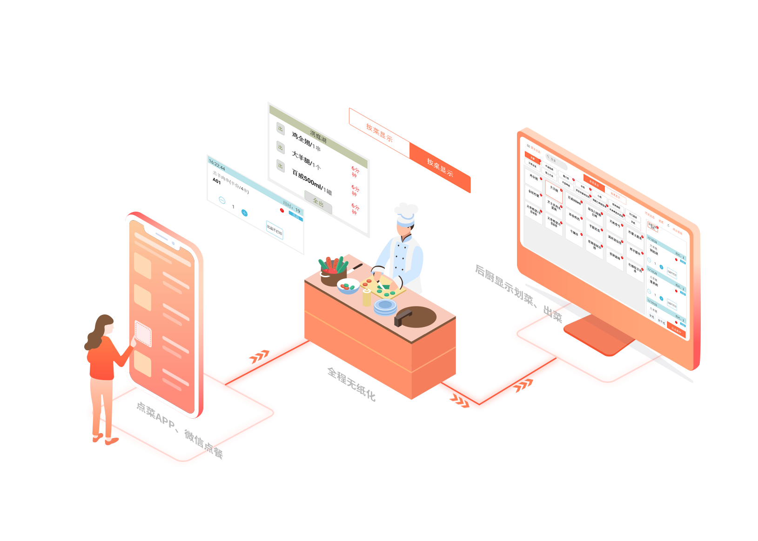
技术优势-KDS智能厨房显示系统
Technical Advantage -KDS Intelligent Kitchen Display System
想了解更多功能，欢迎官网下载试用www.biash.com
Want to explore more features? Download and try from our official website: www.biash.com
爱宝美食云KDS智能厨房
Aibao Food Cloud KDS Smart Kitchen
- 多档口协同制作 -
Collaborative production at multiple stalls
爱宝KDS智能厨房可以将前台顾客订单信息实时传输到厨房显示屏上，后厨根据屏幕显示内容进行菜品制作和出品管理。
The Aibao KDS smart kitchen can transmit the order information of customers at the front desk in real time to the kitchen display screen. The back kitchen can prepare dishes and manage the output based on the content displayed on the screen.
优化制作流程
Optimize the production process
支持按订单、按菜品、按桌台显示订单，厨师可根据实际情况选择适合的模式，快速制作。
Support the display of orders by order, dish or table. Chefs can choose the appropriate mode according to the actual situation to make quickly.
精准显示订单
Accurately display the order
清晰显示订单详细信息，包括菜品名称、数量、特殊要求等，减少了因信息传递不准确导致的错单、漏单现象。
Clearly display the detailed order information to reduce the occurrence of wrong or missed orders.
减少沟通成本
Reduce communication costs
电子屏幕显示订单，避免了口头传达的弊端，减少了厨师与前台之间的沟通成本
The electronic screen displays orders, reducing the communication cost between the chef and the front desk
出品时间管理
Production time management
支持设置菜品出品时间，厨师可根据时间要求合理安排制作顺序，确保菜品按时出品，提升了菜品制作的准确性和及时性。
Support setting the serving time of dishes to ensure they are served on time

Slide 10

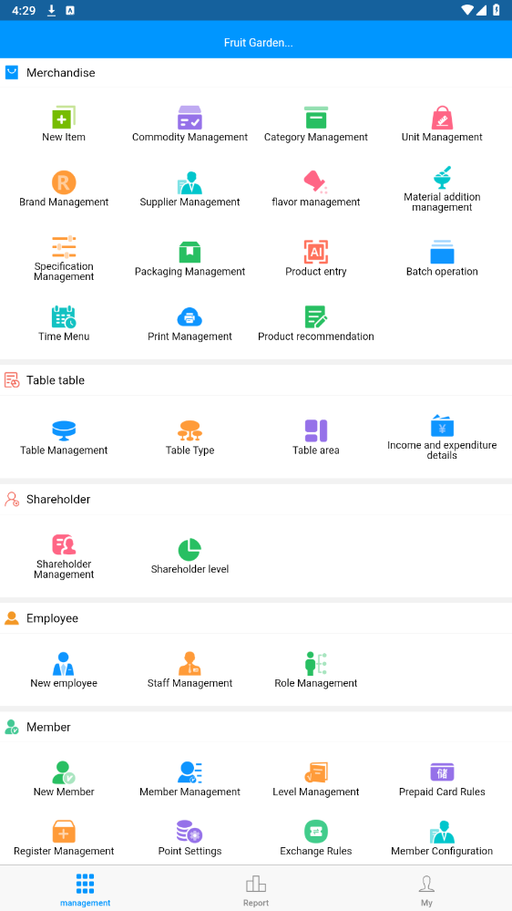
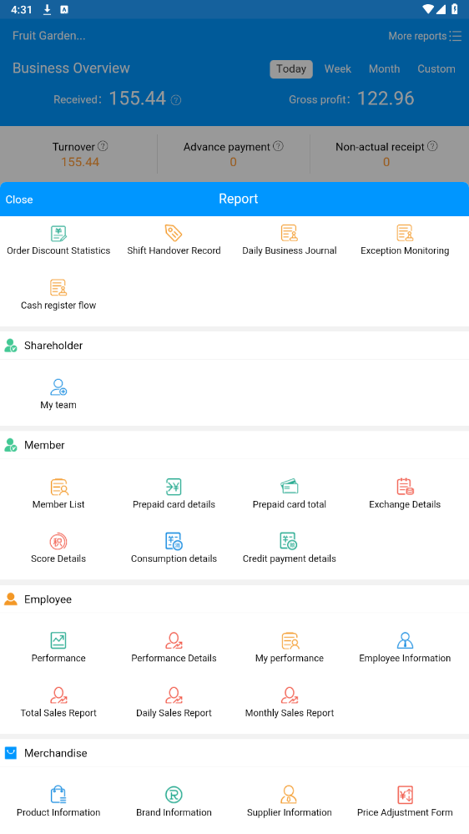
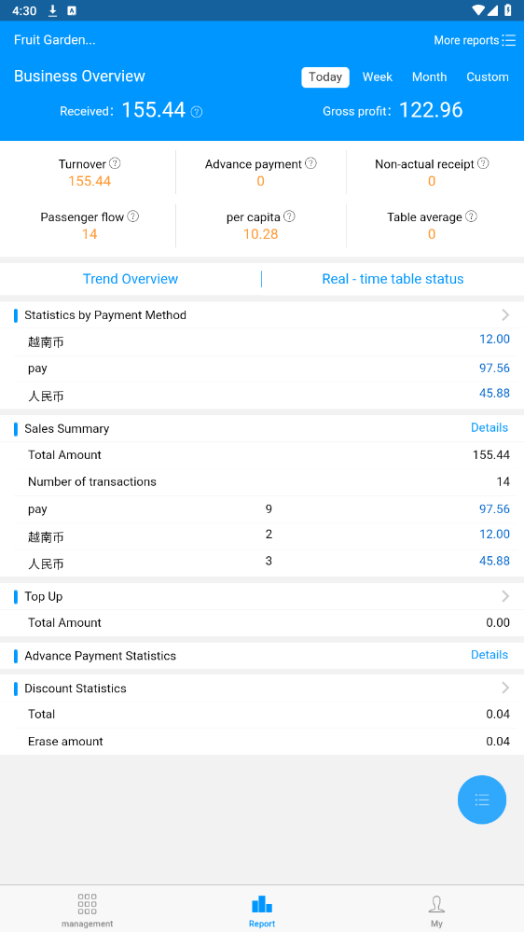
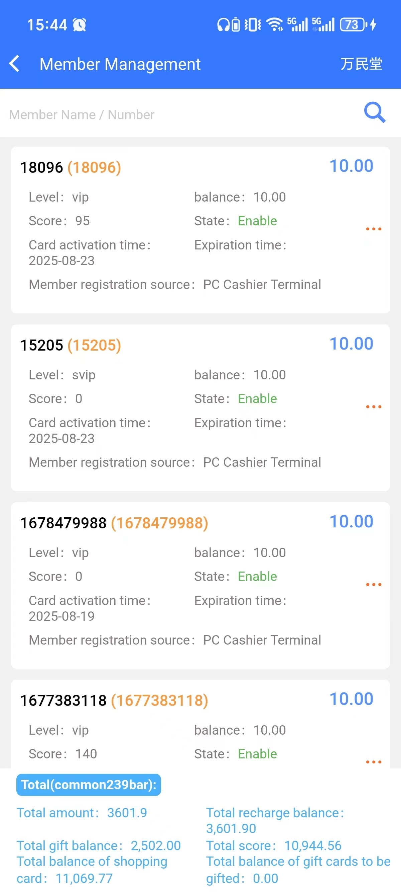
002
技术优势-支持手机APP管理
Technical advantage - Supports management via mobile APP
想了解更多功能，欢迎官网下载试用www.biash.com
Want to explore more features? Download and try from our official website: www.biash.com
支持手机端商品管理、员工管理、活动营销、经营报表查、库存数据等全部功能，智能推送店铺消息，真正把生意装进手机，随时管理决策更高效。
It supports all functions on mobile devices, including product management, employee management, event marketing, business report checking, inventory data, etc. It intelligently pushes store messages, truly integrating business into mobile phones for more efficient management and decision-making at any time.
收银功能

Slide 11
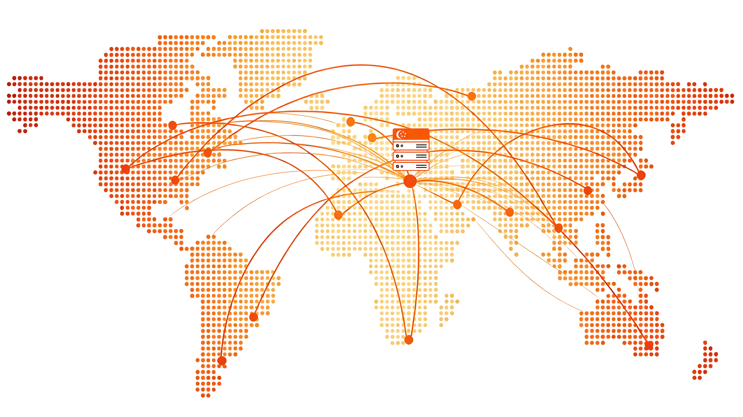
海外适配-海外服务器
Overseas adaptation-Compatible with overseas time zones
想了解更多功能，欢迎官网下载试用www.biash.com
Want to explore more features? Download and try from our official website: www.biash.com
爱宝美食云海外版服务器配置在海外
The overseas version of the integrated cashier solution of Meishiyun
更快的响应速度Faster response speed
海外用户访问速度显著提升，延迟大幅降低
The access speed for overseas users has been significantly improved and the latency has been greatly reduced
更稳定的连接A more stable connection
避免跨国网络拥堵，全天候可用，用户体验更流畅
Avoid cross-border network congestion, available 24/7, and enjoy a smoother user experience
更严格的数据保护Stricter data protection
符合当地数据保护法，数据隐私与法规遵从性更强
It complies with local data protection laws, providing stronger data privacy and regulatory compliance
更贴合当地需求的体验An experience that better meets local needs
服务器可自动适配当地税率、多币种换算和语言服务
The server can automatically adapt to local tax rates, multi-currency conversion and language services

Slide 12

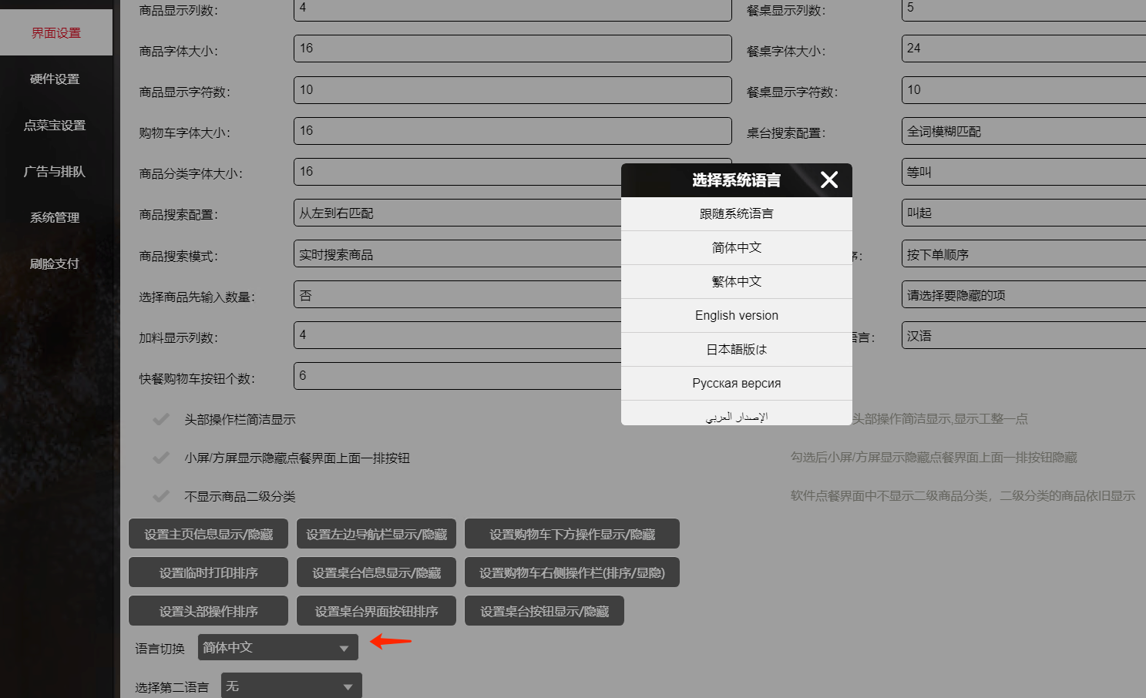
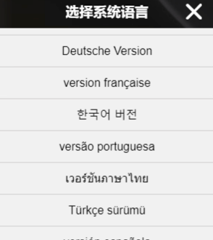
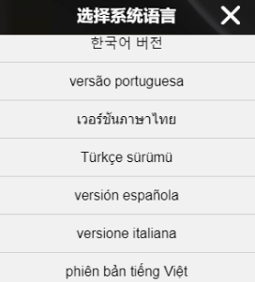
003
海外适配-多语言支持
Overseas adaptation-Multilingual support
想了解更多功能，欢迎官网下载试用www.biash.com
Want to explore more features? Download and try from our official website: www.biash.com
- 多语言国际化 -
Multilingual internationalization
爱宝美食云海外版支持多国语言
The overseas version of Aibao Food Cloud supports multiple languages
目前支持语言：中文、繁体、英文、日语、俄语、泰语、韩语、越南语、德语、阿拉伯语、法语、葡萄牙语、土耳其语、西班牙语、意大利语等
Currently supported languages: Chinese, Traditional Chinese, English, Japanese, Russian, Thai, Korean, Vietnamese, German, Arabic, French, Portuguese, Turkish, Spanish, Italian, etc

Slide 13
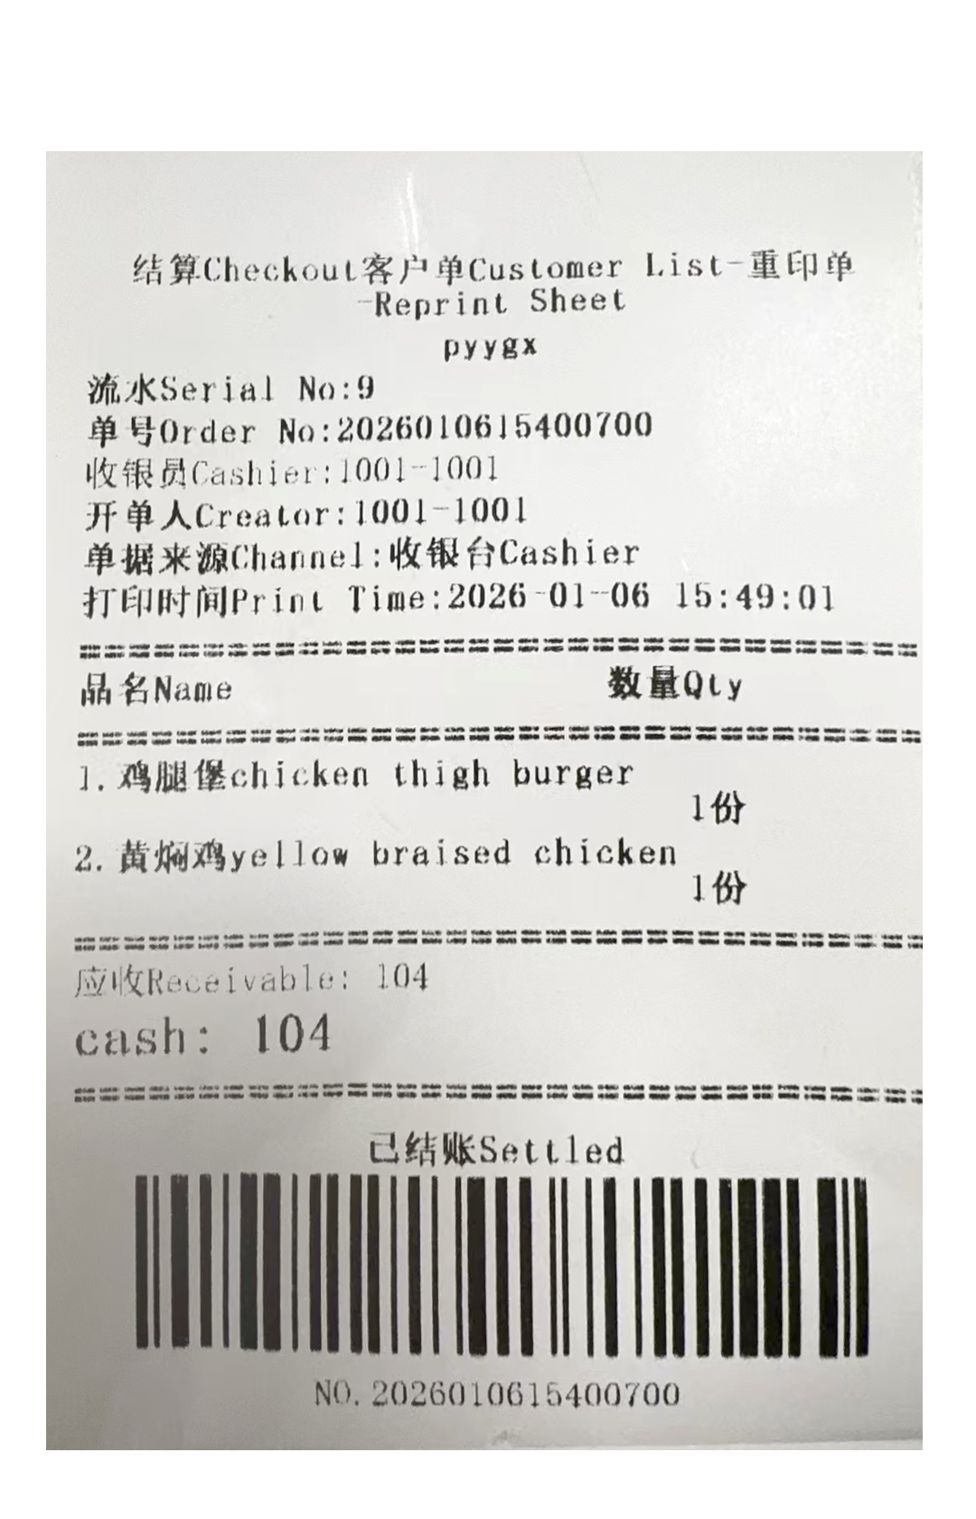
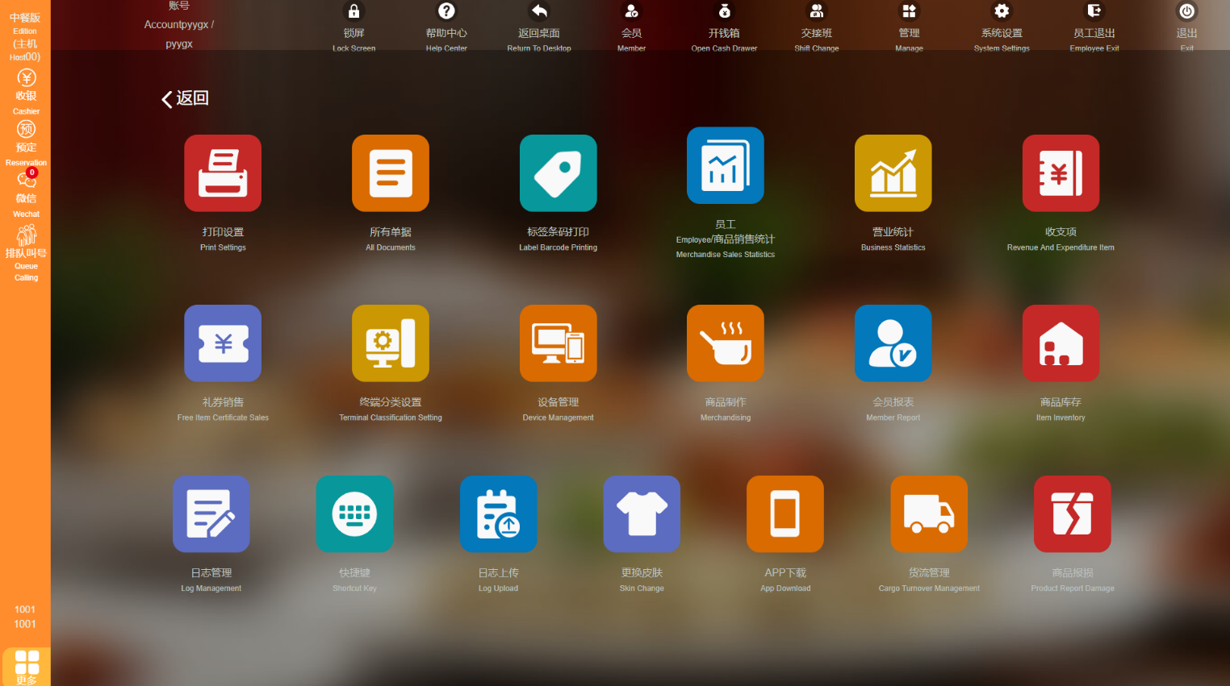
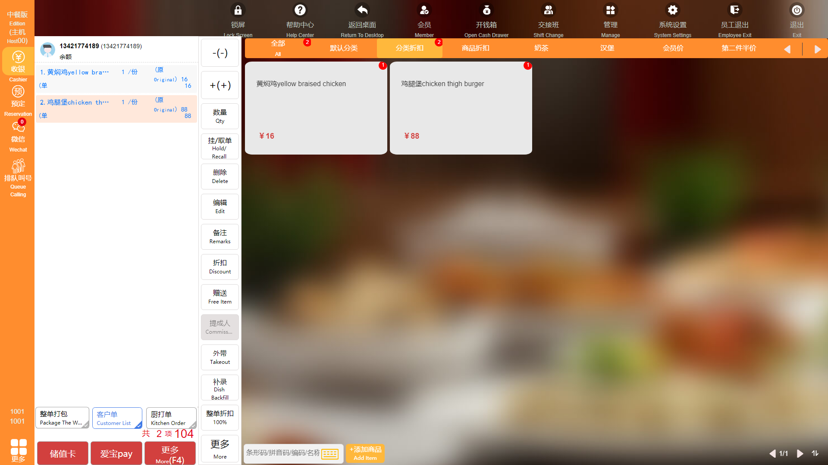
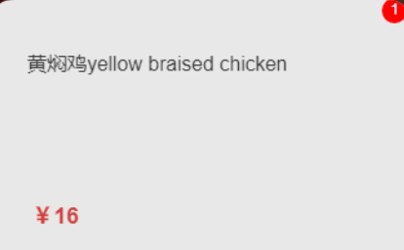


003
海外适配-支持双语打印、双语点餐
Overseas adaptation-Supports bilingual printing and bilingual ordering
想了解更多功能，欢迎官网下载试用www.biash.com
Want to explore more features? Download and try from our official website: www.biash.com
**双语打印**
Bilingual printing
**双语点餐**
Bilingual ordering

Slide 14
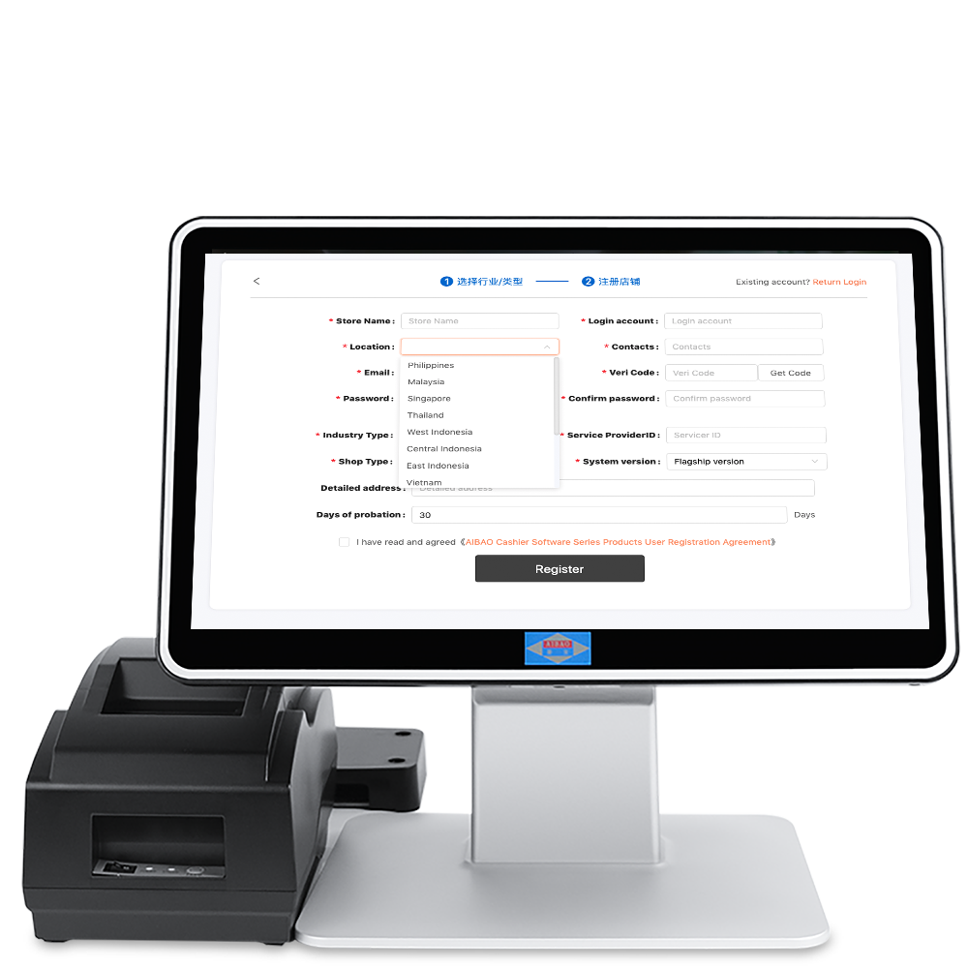
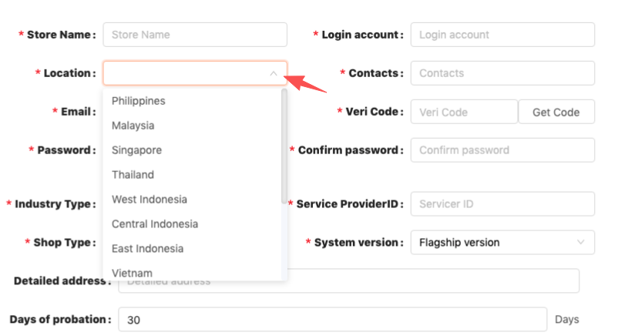
海外适配-兼容海外时区
Overseas adaptation-Compatible with overseas time zones
想了解更多功能，欢迎官网下载试用www.biash.com
Want to explore more features? Download and try from our official website: www.biash.com
支持时区与区域设置，解决跨时区营业数据同步问题。
Supports time zone and regional Settings to solve the problem of business data synchronization across time zones.
兼容海外时区
登录后可选时区：注册完后进入 Settings --> Account Manager --> Location修改时区
Time zones are selectable after logging in: After registration, go to Settings --> Account Manager --> Location to modify the time zone

Slide 15
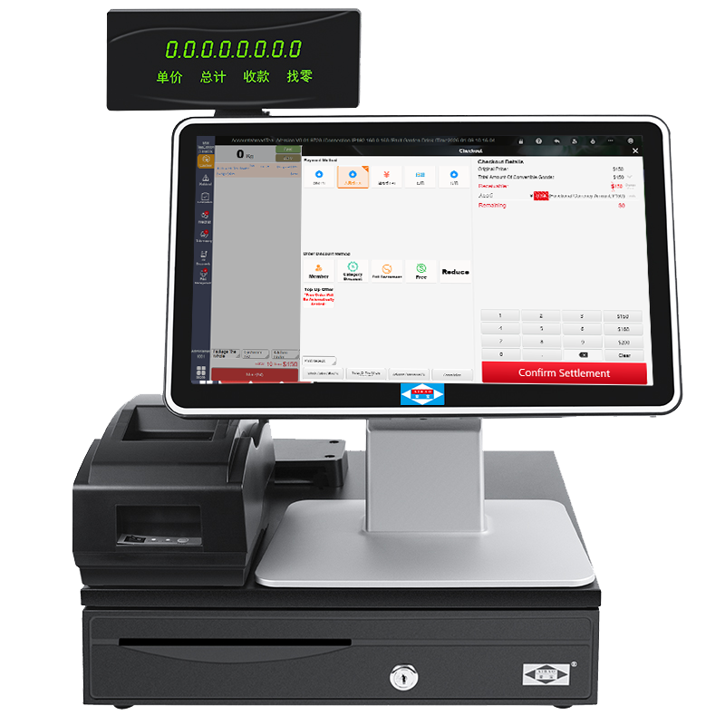
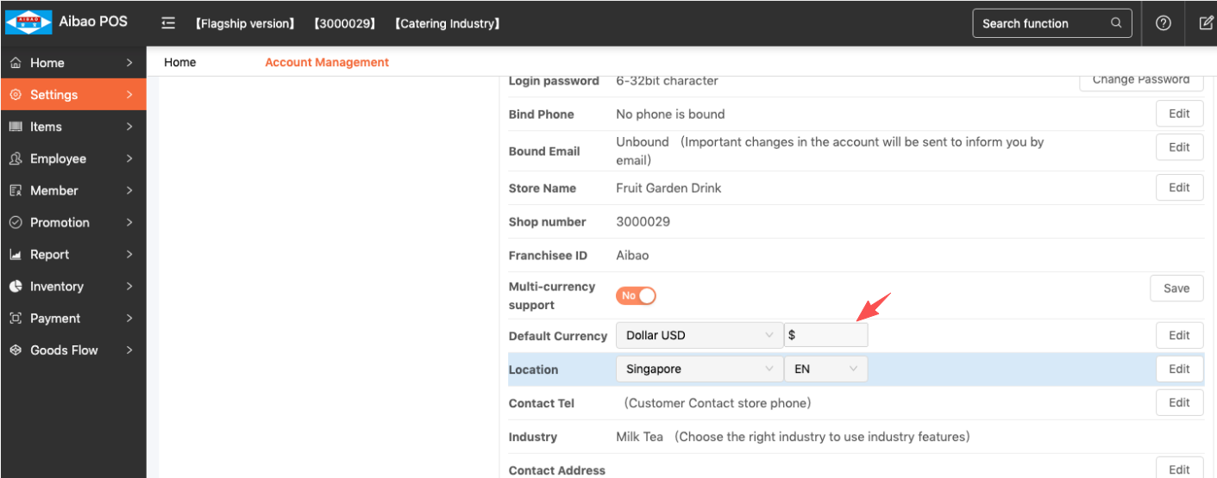
004
海外适配-多币种结算
Overseas adaptation - Multi-currency settlement
想了解更多功能，欢迎官网下载试用www.biash.com
Want to explore more features? Download and try from our official website: www.biash.com
可设置汇率自动换算，小票可自定义显示不同货币符号和金额 Automatic exchange rate conversion can be configured; receipts can be customized to display different currency symbols and amounts
登录后进入 Settings --> Account Manager --> Multi-currency support 开启多币种
Access via the login interface, enter Settings --> Account Manager --> Multi-currency support to enable multiple currencies

Slide 16
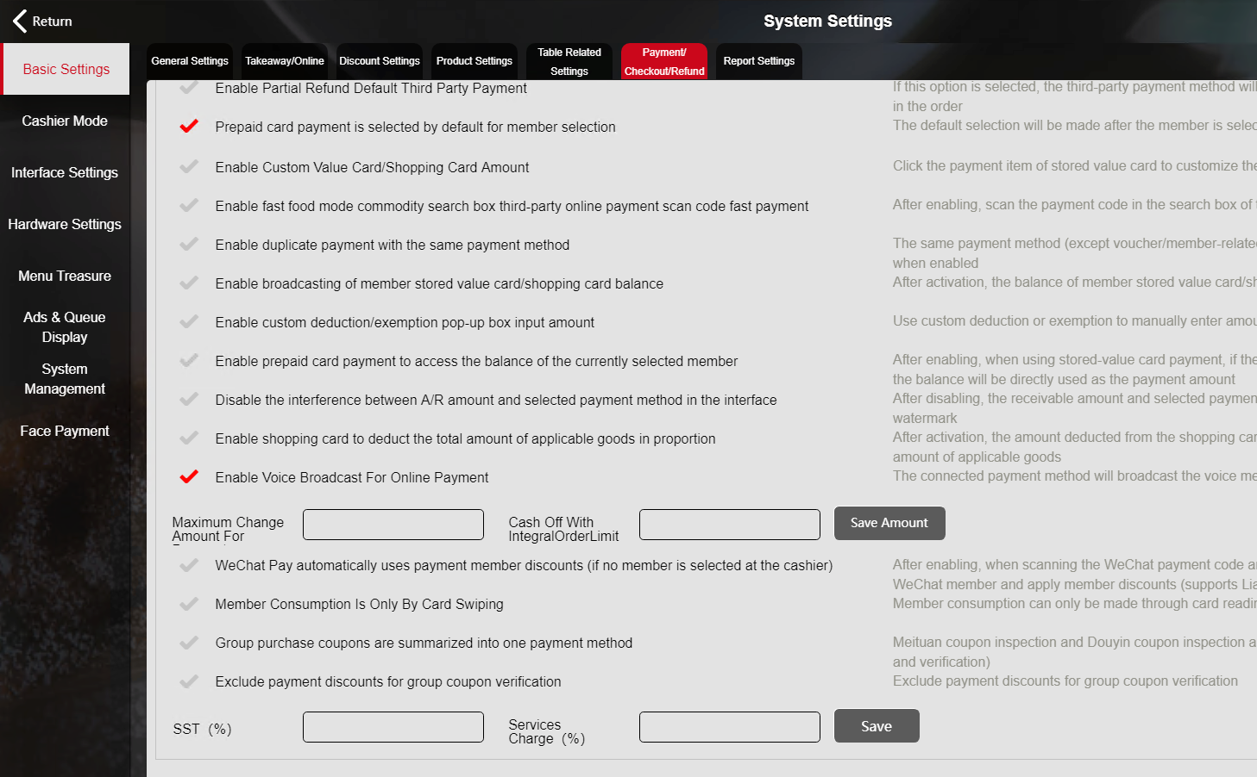
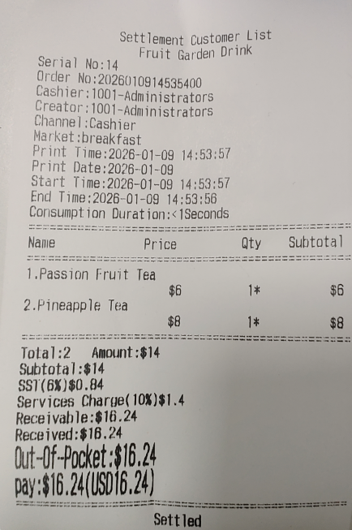
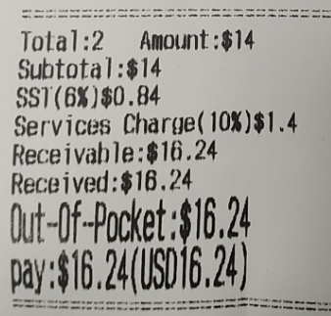
海外适配-税务合规性
Overseas adaptation - Tax Compliance
想了解更多功能，欢迎官网下载试用www.biash.com
Want to explore more features? Download and try from our official website: www.biash.com
专为海外税制设计独立税费计算模块，支持灵活设置SST等税种，符合海外市场的小费文化，支持小费功能设置。
An independent tax and fee calculation module is specially designed for overseas tax systems, supporting flexible Settings of SST and other tax types. It conforms to the tip culture of overseas markets and supports the setting of tip functions.

Slide 17
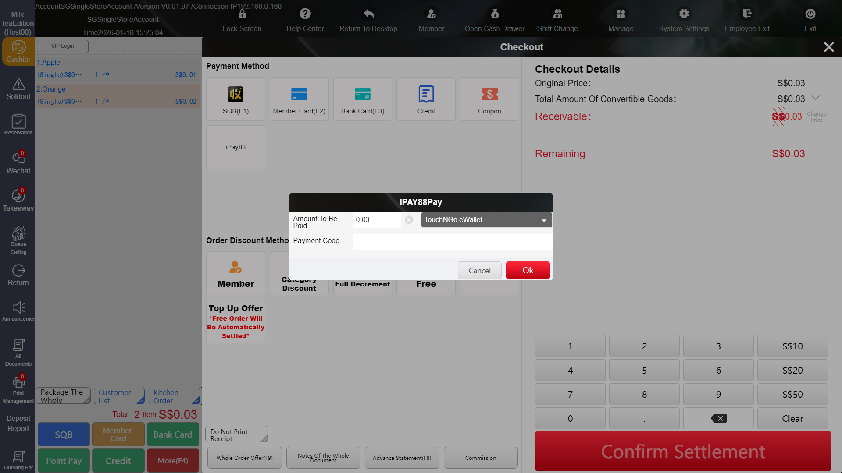
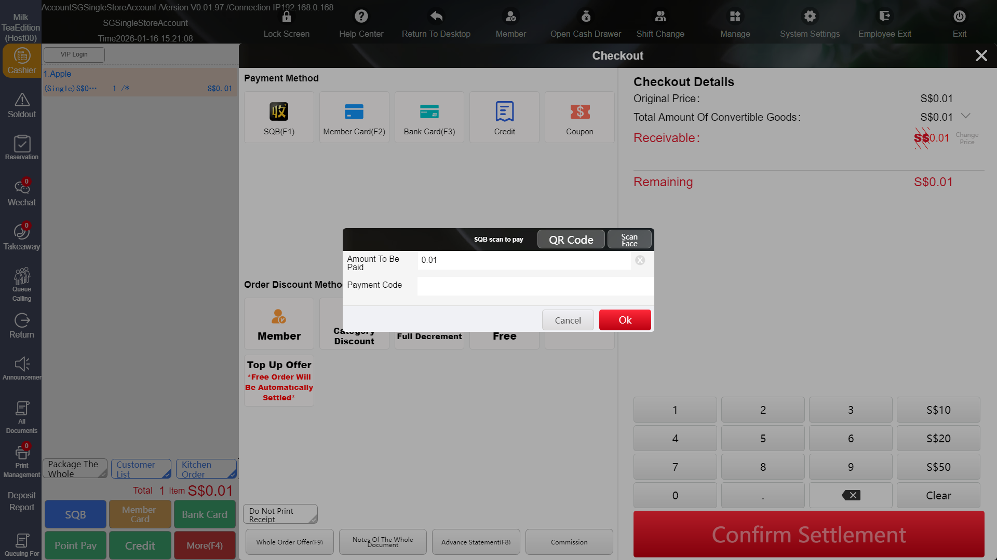
004
海外适配-扫码付
Overseas adaptation - Scan to Pay
想了解更多功能，欢迎官网下载试用www.biash.com
Want to explore more features? Download and try from our official website: www.biash.com
爱宝美食云海外版目前支持IPAY88、收钱吧两种扫码付渠道，马来西亚、新加坡已上线。扫码付便捷快速，大大降低了现金交易的需求。
Aibao Food Cloud Overseas Version currently supports two scan-to-pay channels: IPAY88 and Shouqianba, and has launched in Malaysia and Singapore. Scan-to-pay is convenient and fast, greatly reducing the need for cash transactions.

Slide 18
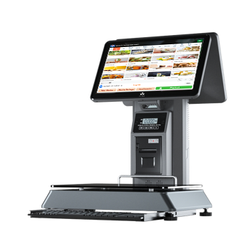
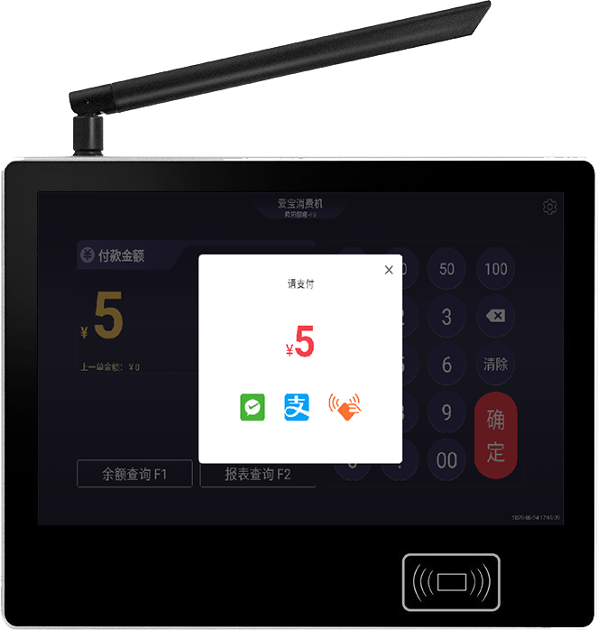
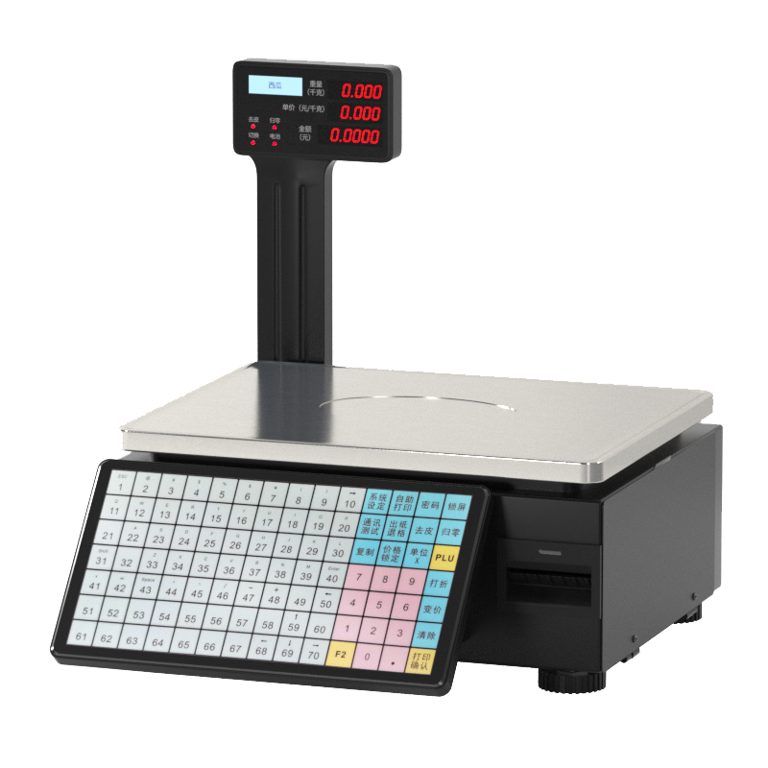
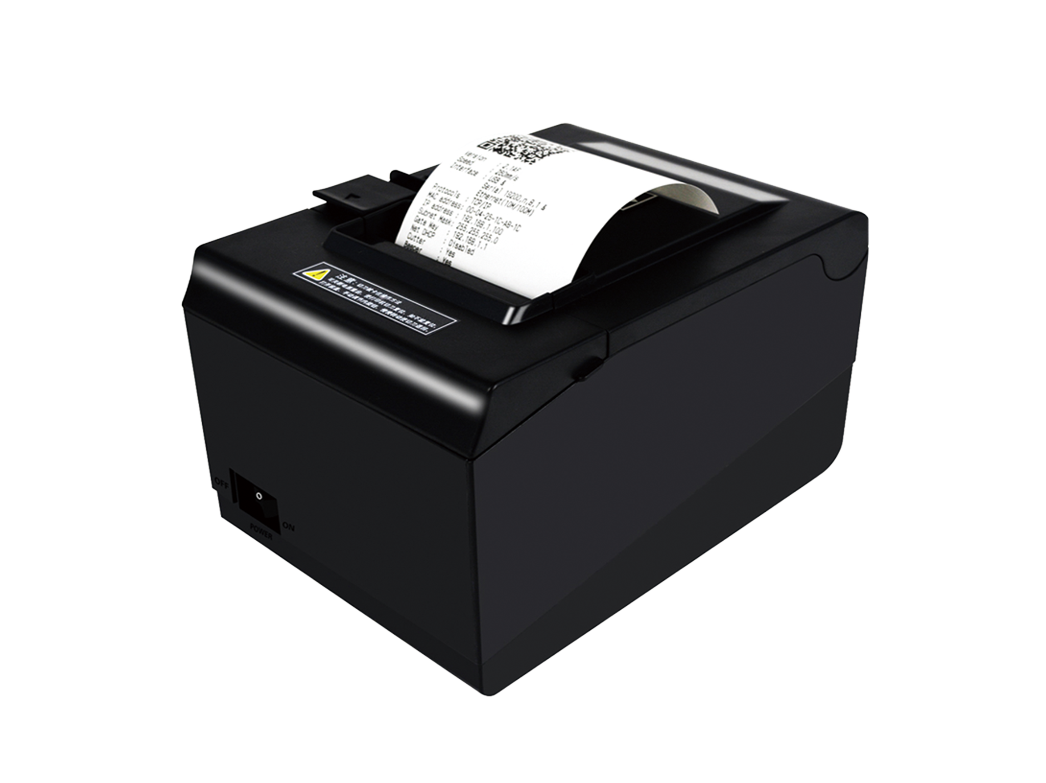
005
兼容各种硬件设备
Compatible with various hardware devices
想了解更多功能，欢迎官网下载试用www.biash.com
Want to explore more features? Download and try from our official website: www.biash.com
爱宝美食云海外版支持针式打印机、热敏打印机、各类计价秤、消费机、平板等硬件，兼容性好
Aibao Food Cloud Overseas Version is compatible with a wide range of hardware devices including dot matrix printers, thermal printers, various pricing scales, POS terminals, and tablets, delivering excellent compatibility.

Slide 19
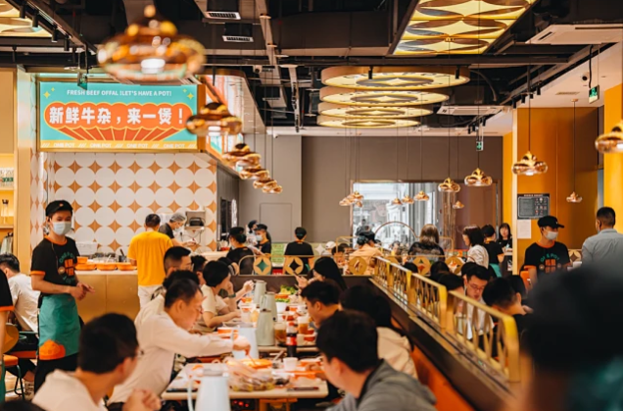
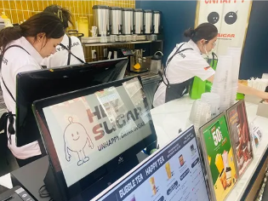
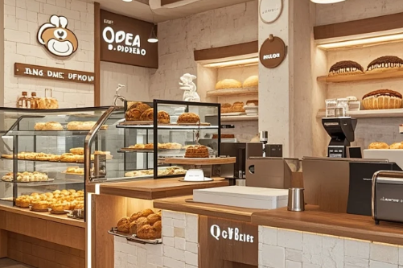
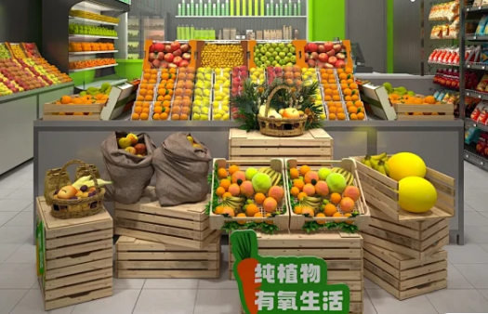


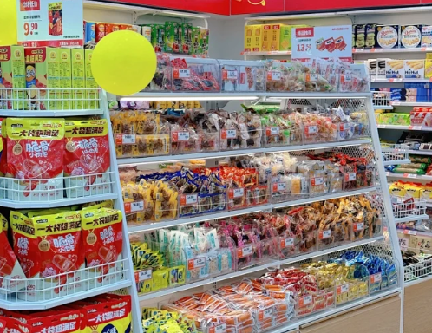
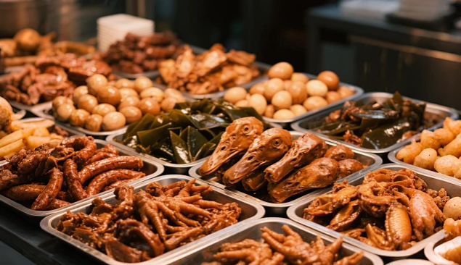
应用场景
Application scenarios
想了解更多功能，欢迎官网下载试用www.biash.com
Want to explore more features? Download and try from our official website: www.biash.com
快餐小店
Fast food store
奶茶小吃店
Milk tea and snack shop
面包烘焙店
Bread bakery
生鲜果蔬店
Fresh produce and fruit store
美食广场
Food Court
各类食堂
All kinds of canteens
零食店
Snack store
卤味称重店
Halal food weighing store

Slide 20
007
爱宝售后服务体系
Aibao After-Sales Service System
想了解更多功能，欢迎官网下载试用www.biash.com
Want to explore more features? Download and try from our official website: www.biash.com
售后服务热线
After-Sales Service Hotline
支持远程协助
Remote assistance supported
总部全国统一技术支持：400-8526-866，用户售后问题、使用问题可拨打需求解决。
National Unified Technical Support Hotline: 400-8526-866. Users can call this number for assistance with after-sales issues or usage problems.
用户遇到问题，打开工具，发送本机识别码及本机验证码发给技术人员，即可远程帮忙设置成功使用。
If users encounter any issues, they can open the tool, send their device ID and verification code to technical staff, and receive remote assistance to successfully configure it for use.
01
04
博客技术文档支持
Blog Tech Docs Support
现场技术支持
On-site Technical Support:
总部建立爱宝博客：http://vblog.aibaocloud.com/，用户使用问题可以在博客中寻找解决方法。
The headquarters has established Aibao Blog at http://vblog.aibaocloud.com/; users can find solutions to their usage problems on the blog.
售后服务体系
Customer Service System
爱宝全国共有1200多个服务网点，如果线上技术无法解决问题，可就近派出线下技术现场支持。
Aibao operates over 1,200 service outlets worldwide. If remote technical support cannot resolve an issue, we can dispatch nearby on-site technicians for in-person assistance.
02
05
微信、QQ服务群WeChat & QQ Service Groups
公众号平台讯息
Official WeChat Account Information
03
06
建立微信服务群，QQ群实时在线，用户可以问题以照片、视频形式发到微信群需求帮助。
Establish WeChat service groups with real-time QQ support. Users can seek assistance by sending photos or videos of their issues to the WeChat group.
客户可以关注【爱宝官方服务】、【爱宝商城汇】【爱宝收银】等微信公众号需求解决。
Customers can follow our official WeChat accounts including Aibao Official Service, Aibao Mall Collection and Aibao Cashier for support with their needs.

